Slide 1
America Divided
Jenny Yun, Sona George, Theo Riotto, Irene Bak, Michael Nangle, Trevor Brown

Slide 2
Main Themes or trends
United States always has an enemy(communism to terrorism)
World community looks to United States as a leader to determine policy on conflicts around the world

Slide 3
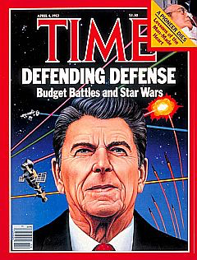
1980's Part 1
Ronald Reagan begins arms buildup
Increased government spending during peacetime
Raises interest in military
Strategic Defense Initiative
Protection from Nuclear Bomb attacks
Stronger weapons, planes, and ships

Slide 4
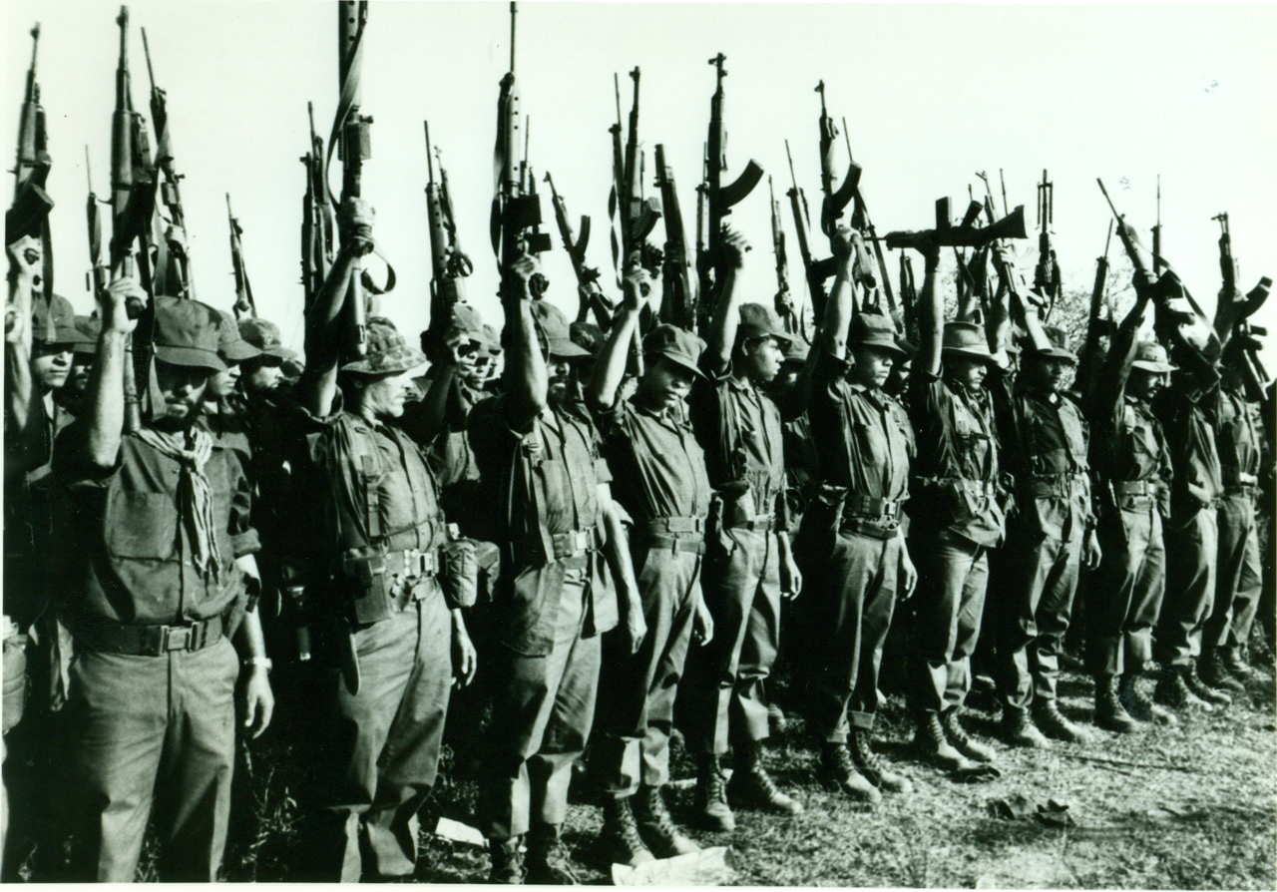
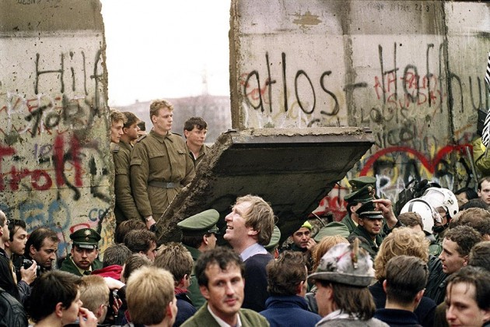
1980's Part 2
United States Arms Contras in Nicaragua
The United States acts as world policeman
Carter in 1980, Reagan in 1981
Financial support vs. Physical arming
Berlin Wall comes down (Nov. 9, 1989)
The Cold War was coming to an end
East Berlin Communist Party spokesperson declared reunification with West Berlin
Memorable event of citizens celebrating and breaking down the wall was televised

Slide 5
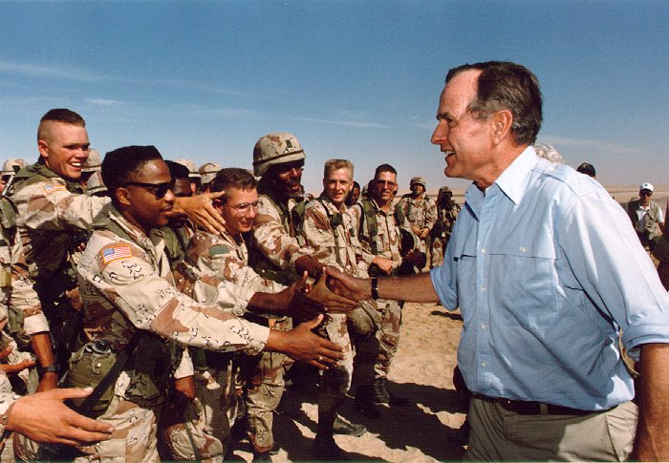
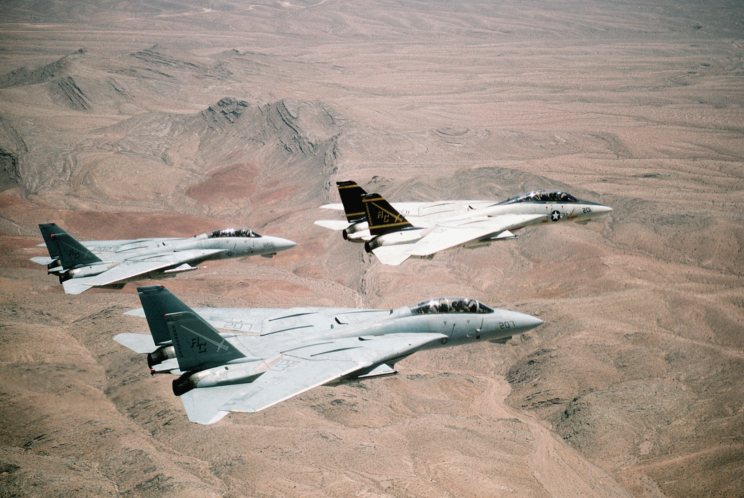
1990’s
Persian Gulf War
August 1990 - Saddam Hussein, leader of Iraq, invades neighboring country Kuwait
Arab leaders (such as Saudi Arabia and Egypt) look to America and other Western powers for help
Operation Desert Storm – American led aerial offensive
42 days later, President George H.W. Bush issues cease-fire after Iraqi forces have retreated

Slide 6
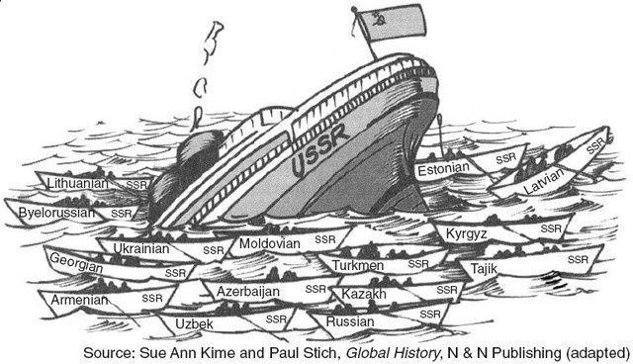
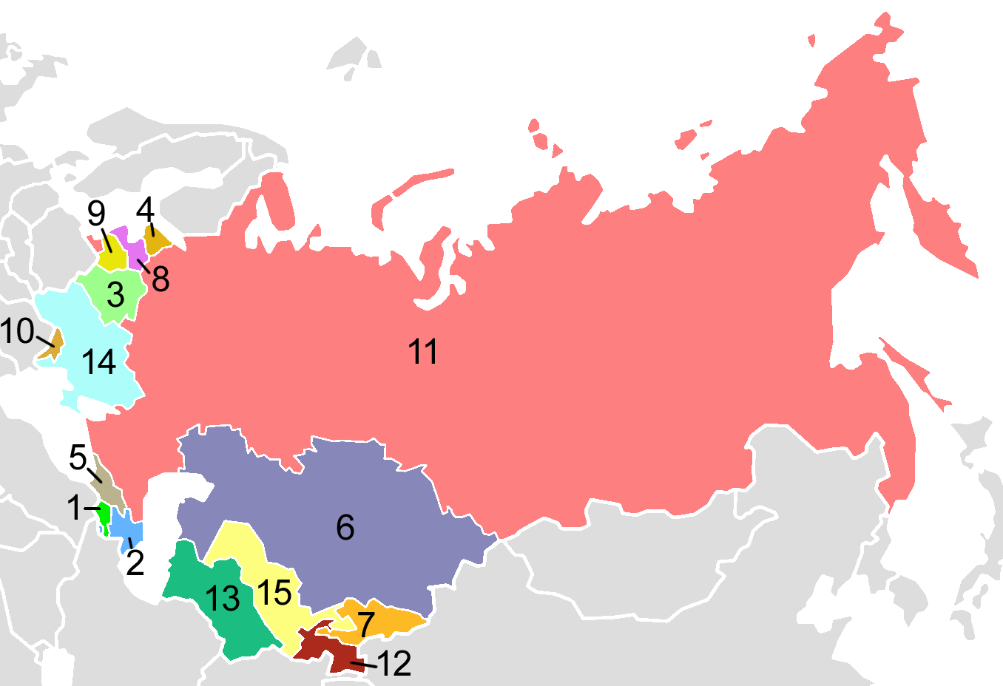
1990's
USSR breaks apart; end of the Cold War (December 1991)
Baltic states (Estonia, Lithuania and Latvia) declared independence from Soviet Union
11 Soviet republics did same soon after
(Ukraine, the Russian Fed., Belarus, Armenia, Azerbaijan, Kazakhstan, Kyrgyzstan, Moldova, Turkmenistan, Tajikistan, and Uzbekistan)
Instead became a Common Wealth of Independent States
Mikhail Gorbachev (former Soviet President) and radical reforms during presidency greatly contributed to the fall

Slide 7
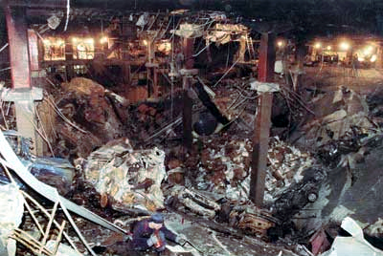
1990’s
Al Qaeda bombs World Trade Center (February 26, 1993)
A truck bomb detonated below the North Tower
The bomb was meant to send the North Tower crashing into the South Tower, but instead the bomb only created a crater in the North Tower and the two buildings remained stable.
6 people died and many more were injured
This was the worst terrorist attack on the nation at the time

Slide 8
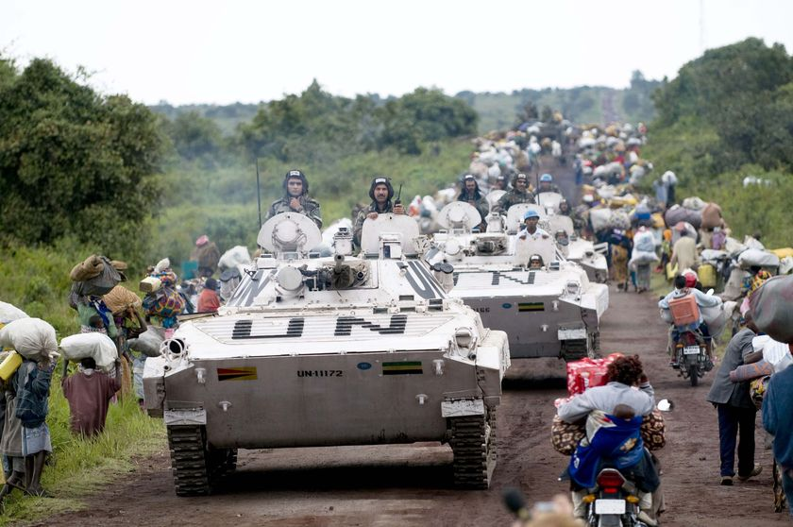
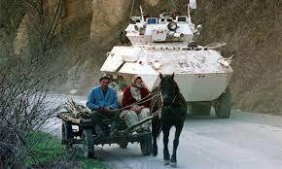
1990’s
UN Peacekeeping Forces in Bosnia
Following break up of Yugoslavia war broke out between Bosnian Serbs and Muslim-Croats
Genocide and concentration camps occurred killing thousands of civilians
UN forces entered Bosnia but only kept peace and protected “safe zones”
World stage looked to American involvement to end conflict
When US entered in force, mainly airstrikes with some troops on ground, tide shifted

Slide 9
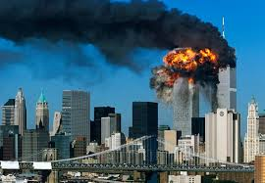
Al qaeda attacks World Trade Center (2000's)
September 11th, 2001
19 members of Al-Qaeda plan and execute an attack
WTC, Pentagon attacked
3000 dead, 6000 injured
President Bush speaks to the nation, calls it a terrorist attack and says that the terrorists/those who harbor them are enemies

Slide 10
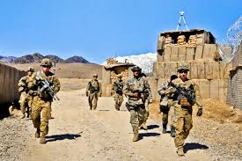
US invades Afghanistan/Iraq (2000's)
Afghanistan (2001/2)
-Al Qaeda blamed for attacks
-Leader, bin Laden, is hiding in Afghanistan
-Afghanistan refuses to give him up
-Bombing starts in October, troops follow
Iraq (2004)
-Iraq possibly developing WMD's
-Hussein has connections to terrorist organizations
-Wanted to help build a nation of Iraq
-Oil

Slide 11
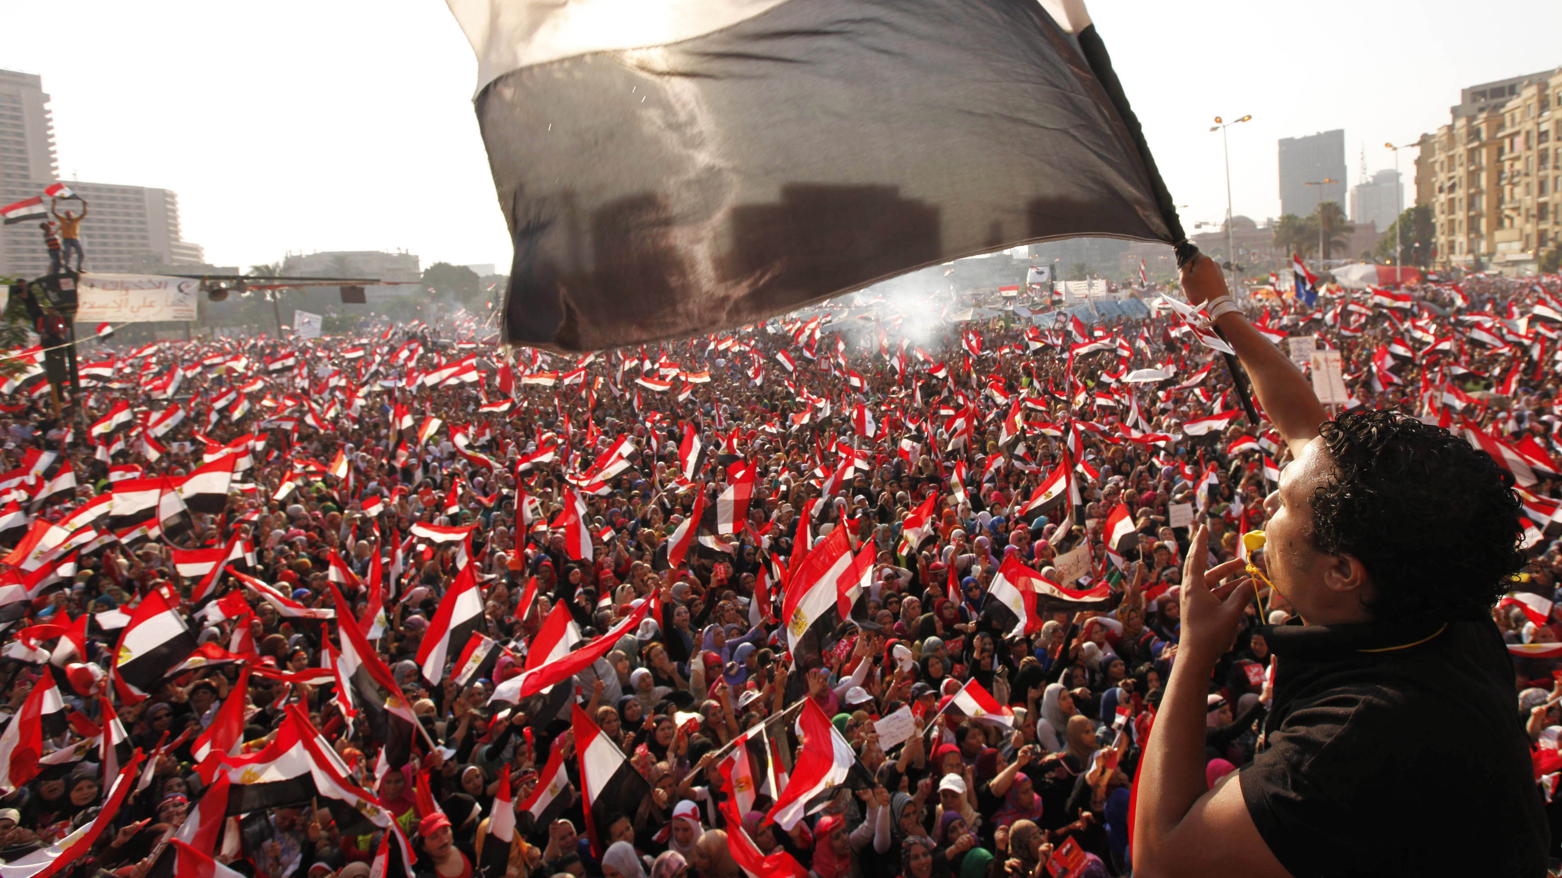
Arab Spring (2010-2012)
Democratic Uprising
Origin: December 2010 in Tunisia
Mohammed Bouazizi
Self immolation
Police corruption and ill treatment
"Burning Man"
September 2012: Government overthrown in four countries
Use of texting, emailing, and blogging
Violence from authorities
Took hold in Egypt, Libya, Syria, Yemen, Bahrain, Saudi Arabia, and Jordan
US continuation of security policy

Slide 12
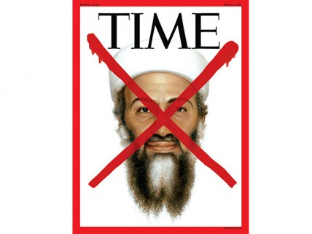
Osama bin Laden killed
May 2, 2011
Killed by U.S. Navy SEALs
No American were injured
Buried at undisclosed location in Arabian Sea
Islamic practice
"Justice has been done"
Bin Laden made plans to..
Assassinate President Obama
Additional attacks against America

Slide 13
last combat troops withdrawn from iraq
Began: December 2007
Completed: December 2011
U.S.-Iraq Status of Forces Agreement
Deadline: December 31, 2011
"All the United States Forces shall withdraw from all Iraqi territory"
"I just can't wait to call my wife and kids and let them know I am safe," ~Sgt. First Class Rodolfo Ruiz
Resume operations: June 2014
Defend against ISIL
Current troops: less than 40,000 soldiers in Iraq

Slide 14
